Slide 1
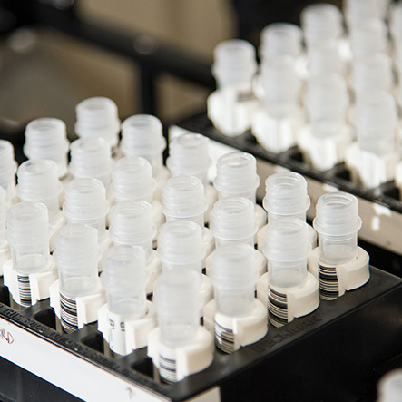

Business Management Meeting

Slide 2
SOFT Analysis – Scientific Support
Successes Handover from Data Leads Training on the Core lab operations Project: RDC (Presented in the DQA meeting) Sample Contamination Analysis based on the DNA purity and Yield | Failures
Opportunities Setup Project board in JIRA Setup Document Management in Git Training the team on JIRA and Git Analysis of Core projects based on the priorities | Threats (Risk) The communication protocol needs to setup between the Core and the Scientific Support team

Slide 3
Key Objectives

